Slide 1
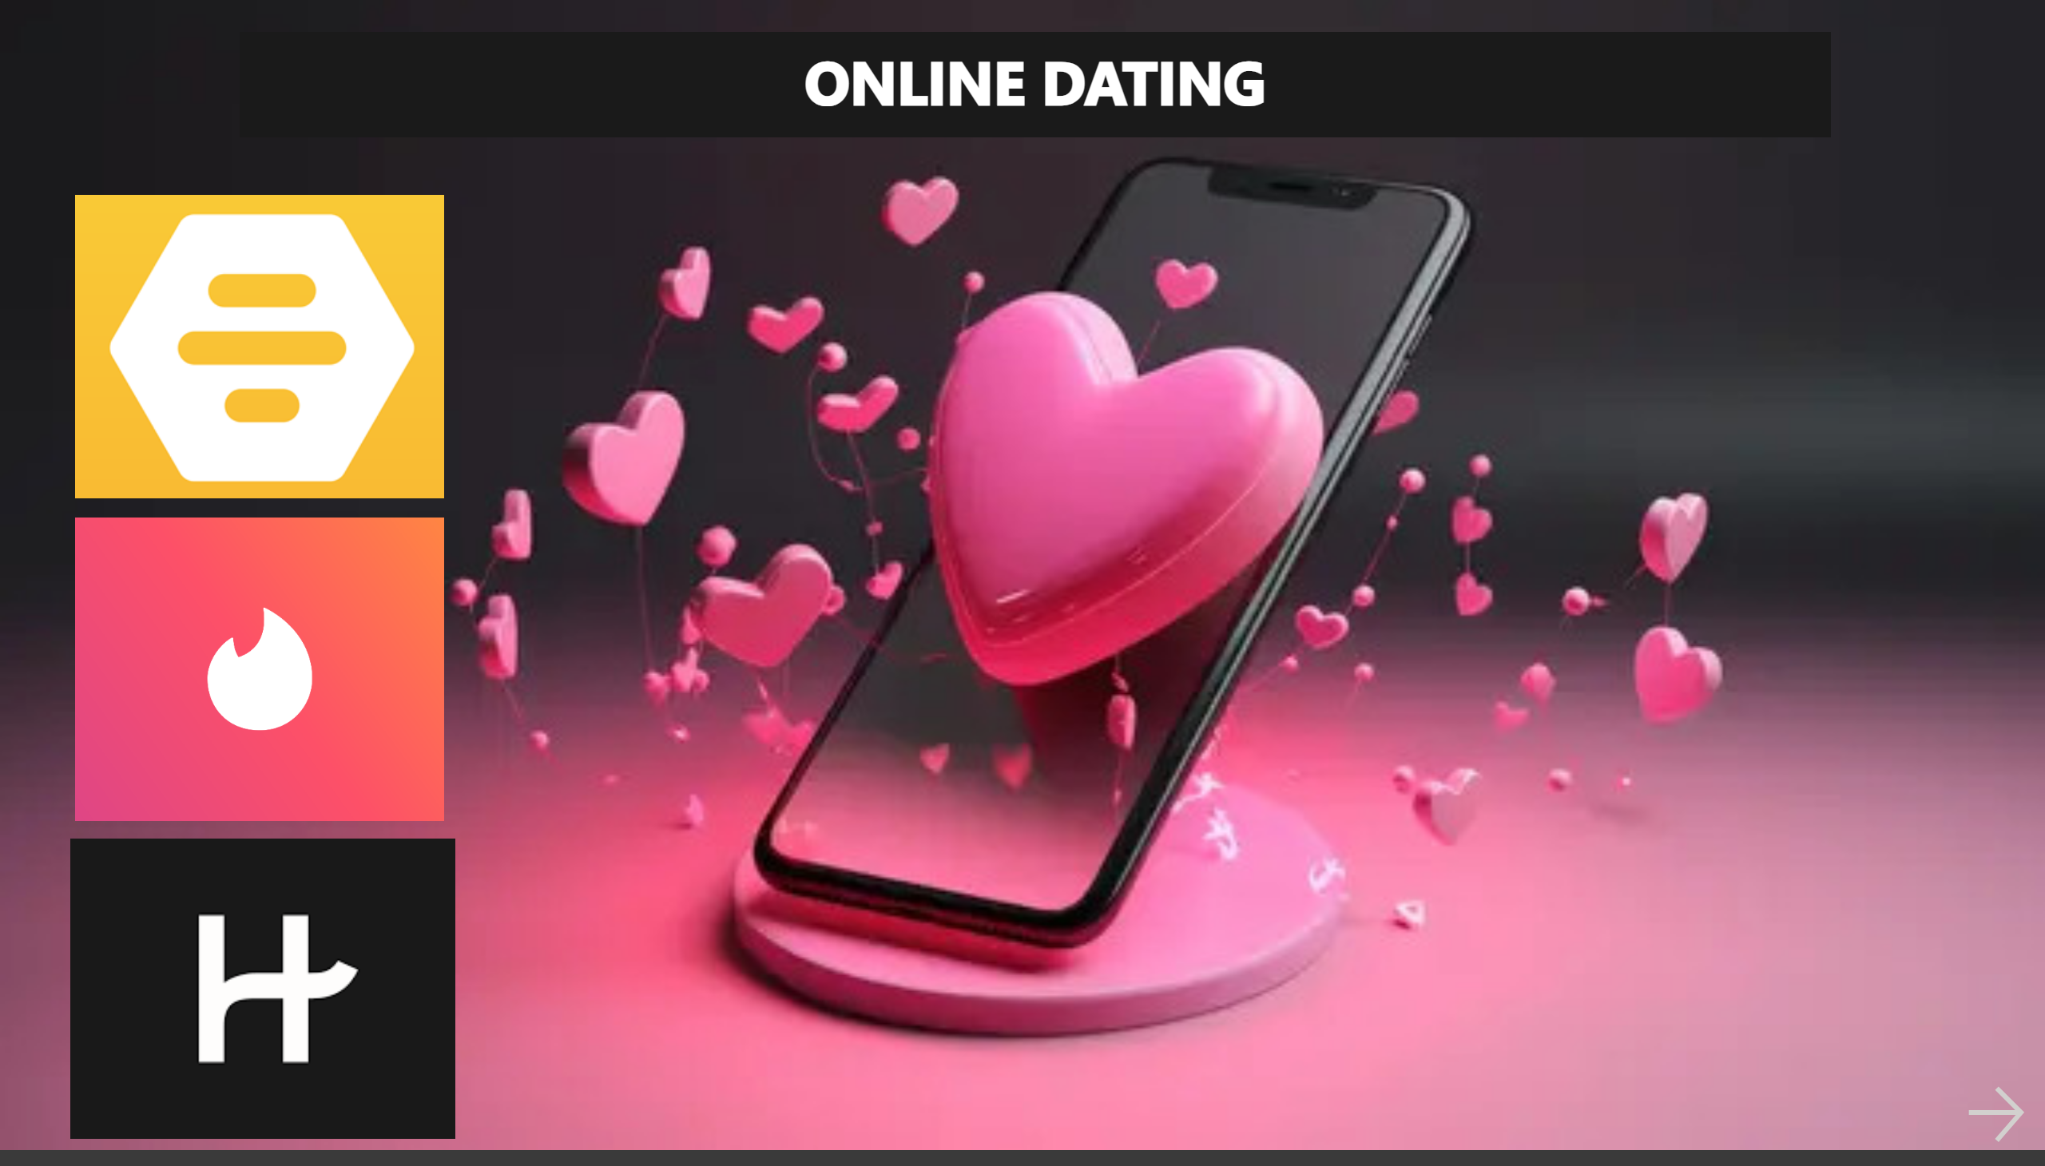
Title
Notes:
textbox
No alt text provided
image
No alt text provided
image
No alt text provided
image
No alt text provided
actionButton
No alt text provided

Slide 2
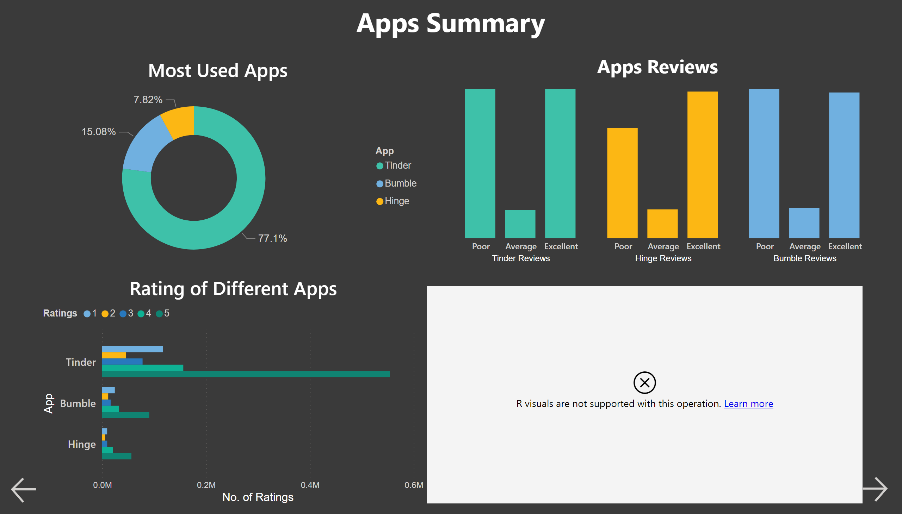
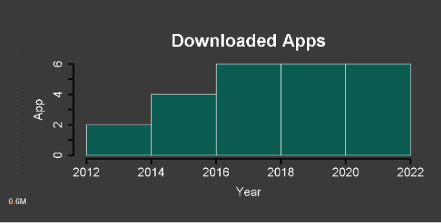
Summary
Notes:
textbox
No alt text provided
Apps Review
No alt text provided
Apps Review
No alt text provided
Apps Review
No alt text provided
textbox
No alt text provided
scriptVisual
No alt text provided
Most Used Apps
No alt text provided
Rating of Different Apps
No alt text provided
actionButton
No alt text provided
actionButton
No alt text provided

Slide 3
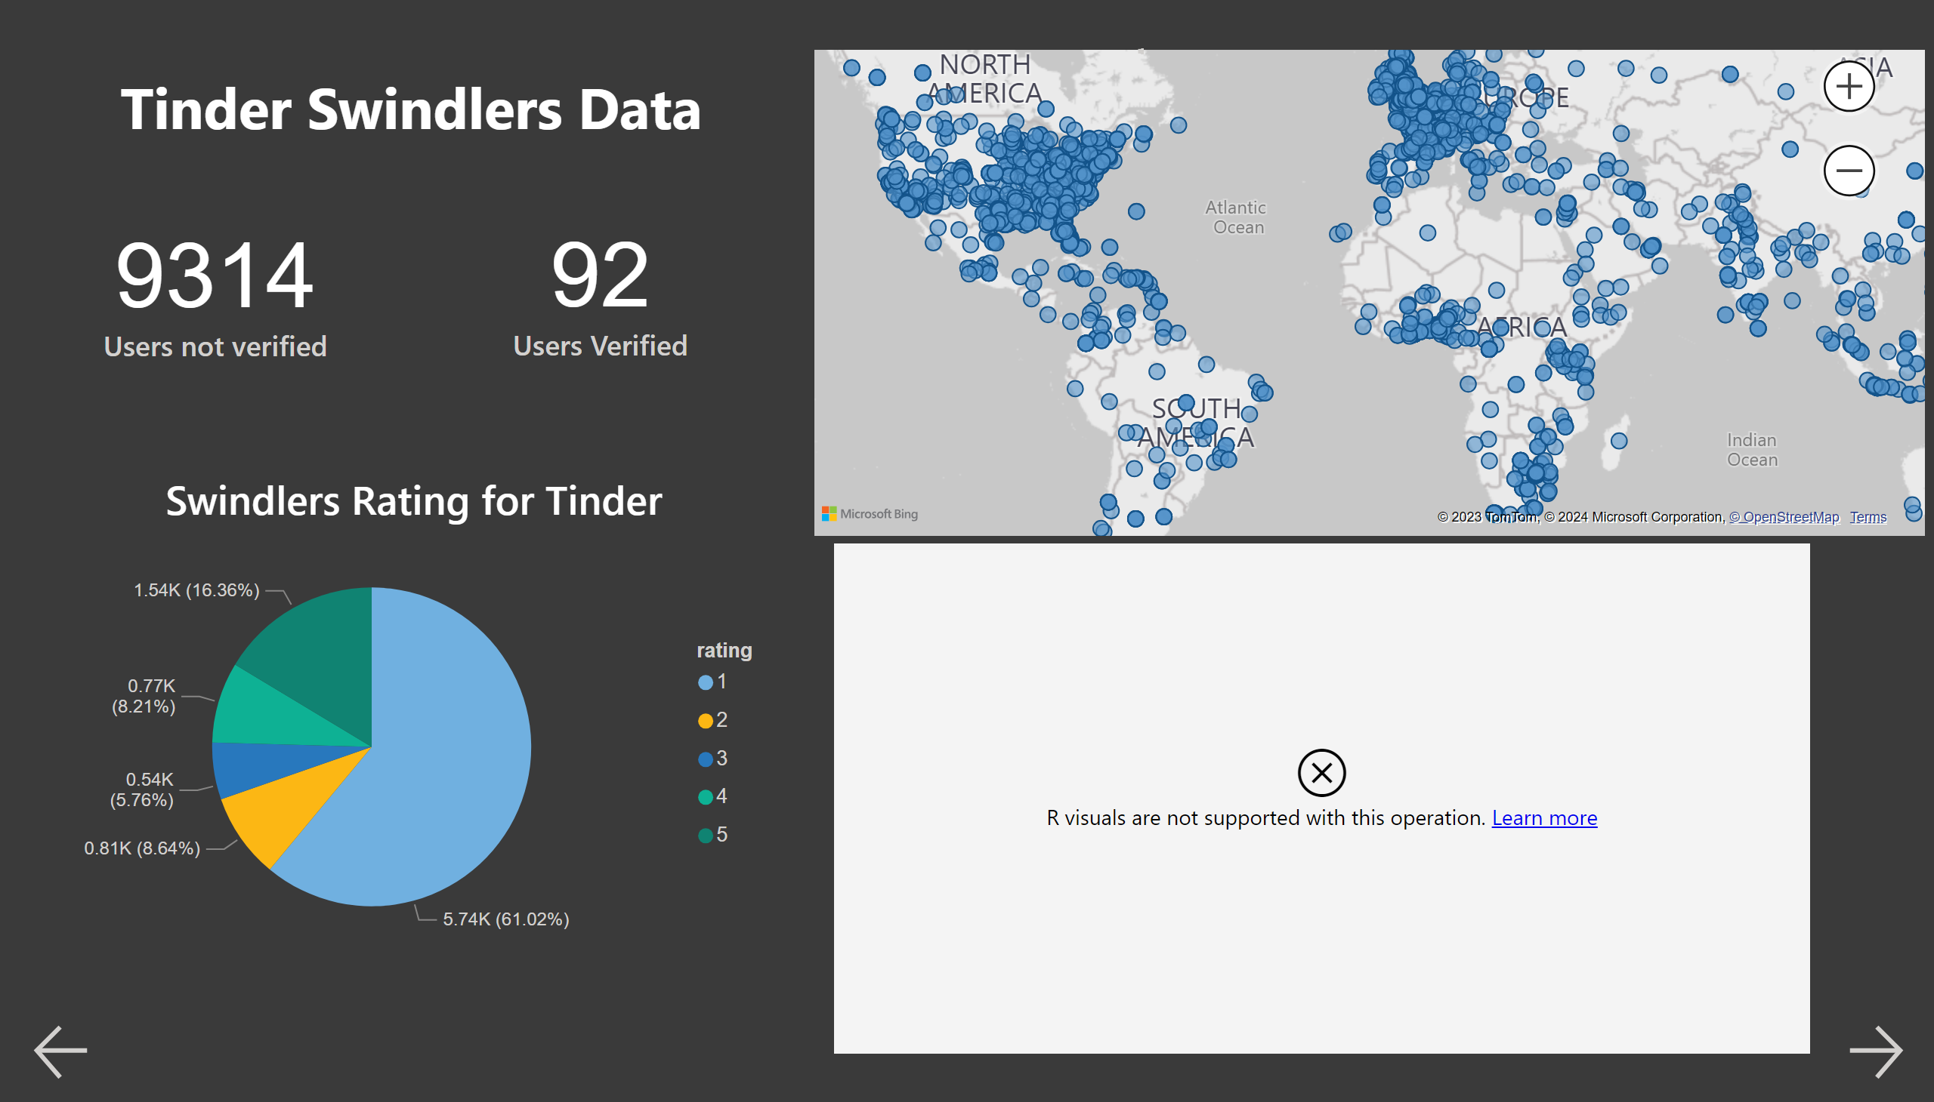
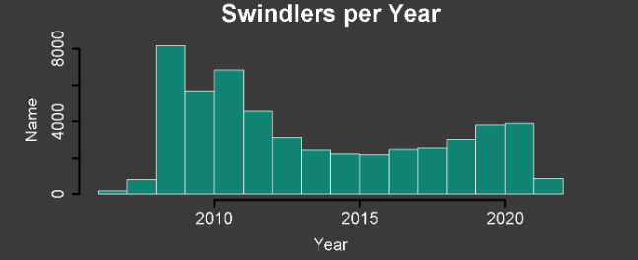
Swindlers
Notes:
textbox
No alt text provided
card
No alt text provided
card
No alt text provided
Swindlers Rating for Tinder
No alt text provided
scriptVisual
No alt text provided
map
No alt text provided
actionButton
No alt text provided
actionButton
No alt text provided
actionButton
No alt text provided

Slide 4
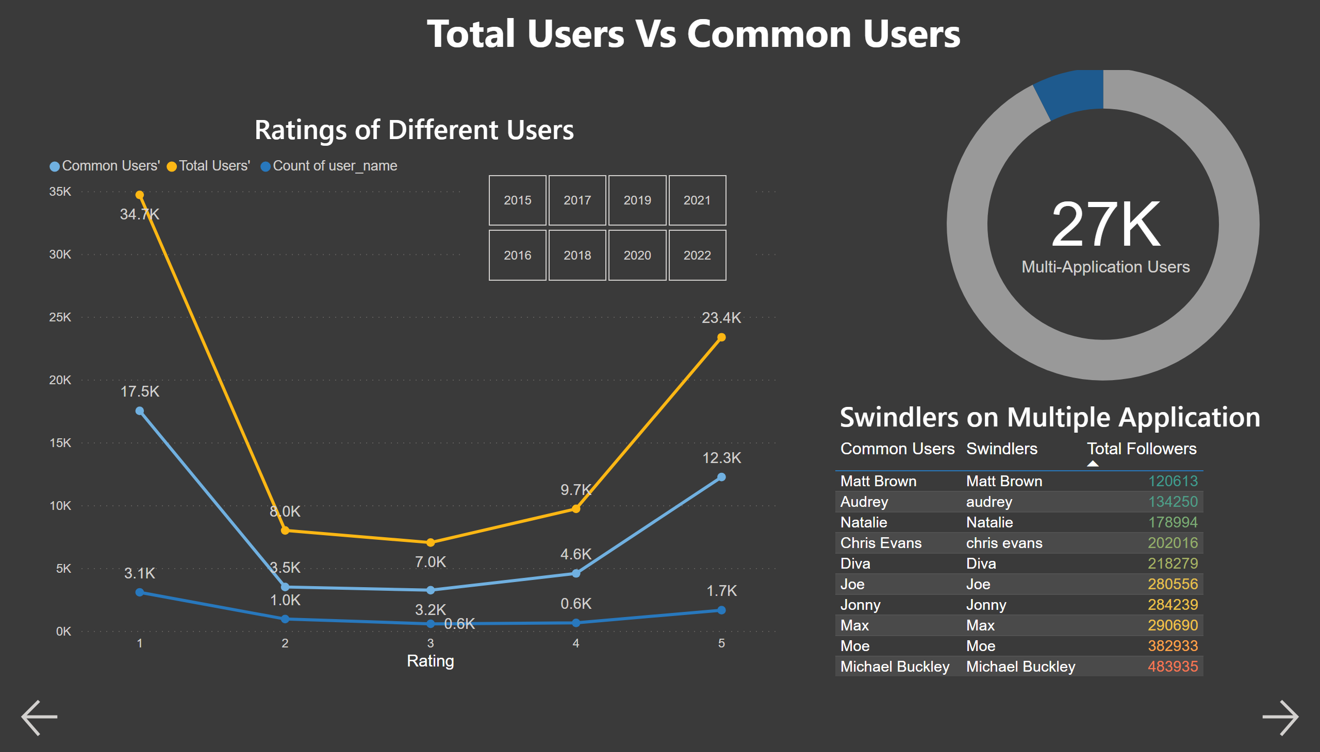
Users Comparison
Notes:
card
No alt text provided
donutChart
No alt text provided
slicer
No alt text provided
Ratings of Different Users
No alt text provided
textbox
No alt text provided
Swindlers on Multiple Application
No alt text provided
actionButton
No alt text provided
actionButton
No alt text provided

Slide 5
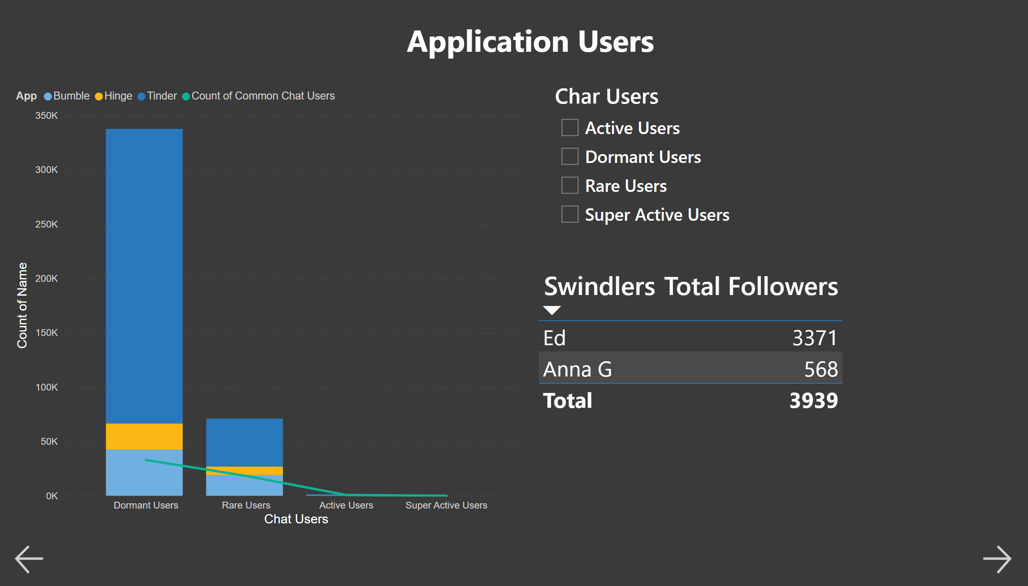
Application Users
Notes:
lineStackedColumnComboChart
No alt text provided
tableEx
No alt text provided
Char Users
No alt text provided
textbox
No alt text provided
actionButton
No alt text provided
actionButton
No alt text provided

